Slide 1
Case Study: Segmentation for Sticks Kebob Shop
Team B:
Jennifer Mead
JC
WG
MM
KT
References
“Market Segmentation. Market Segmentation Research. Marketing Segmentation. Market Segment Research. Prizm from Claritas.” Claritas MyBestSegments, Claritas, LLC, segmentationsolutions.nielsen.com/mybestsegments/.
Venkatesan, Rajkumar, et al. Cutting-Edge Marketing Analytics: Real World Cases and Data Sets for Hands on Learning. Pearson Education, 2015.

Slide 2
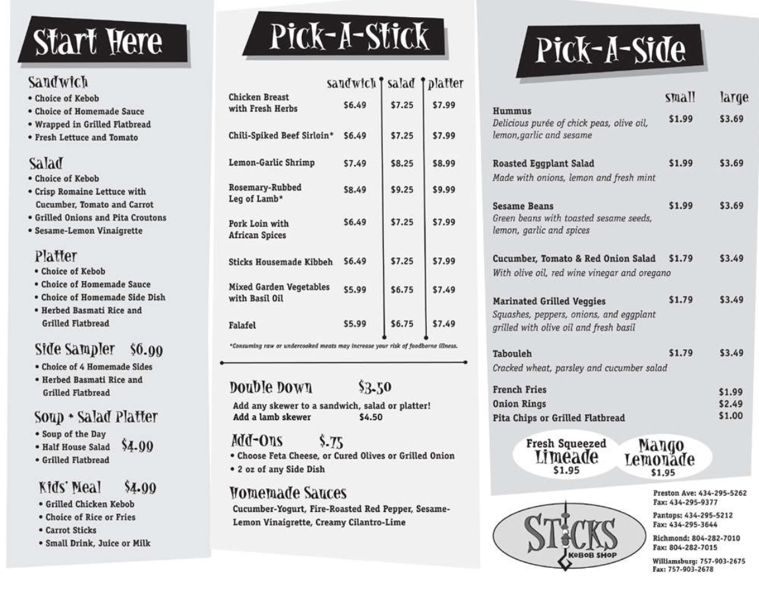
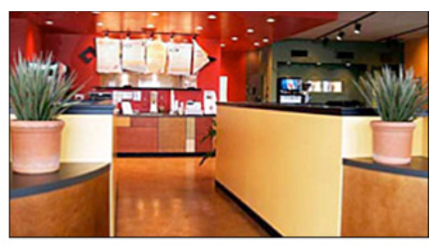
Business Objective: Recommend a new location for Sticks Kebob Shop
Team B
Background
Sticks is a Quick Service Restaurant in the Specialty (healthy/ethnic) category. Goals: To offer high quality, “healthful and satisfying” food in a “less stuffy atmosphere” and to deliver it quickly. To serve ethnic food in accessible ways. To create a “safe haven” for foodies, busy families, “soccer moms”, sports fans, and health-conscious diners. For customers to feel they had made a “smart dining choice”.
Goals for Expansion
Find a new location that has the best-suited customers and then connect with those customers. Expansion will be focused along the I-64 corridor, past Stick’s original college-town niche. Long-term goal: to grow from 4 stores to 8 stores in addition to launching a packaged version of its hummus in retail outlets.
See the case study in Cutting-Edge Marketing Analytics for more details.

Slide 3
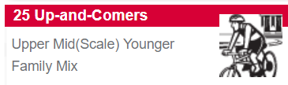
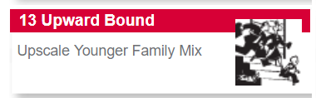
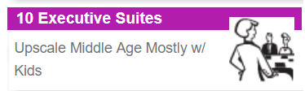
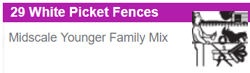
Profiles: Four groups with clear priorities
Team B
 | 1 | 2 | 3 | 4
Nickname | Control Spending | Buy Locally | Plan Carefully & Consider Health | Plan, Control, & Consider
Demographic* | Spends the least | Highest income and with the fewest kids | Oldest | Lowest income, youngest, most kids
Psychographic | Highest score on “I sometimes have trouble controlling my spending” | Highest score on “I think it is important to purchase products that are made locally” | Highest score on “I tend to plan things very carefully” and “I carefully consider the health benefits of what I eat” | Second-highest score on “plan things very carefully”, “trouble controlling my spending” and “consider the health benefits of what I eat”
PRIZM Profile | Up-and-Comers | Upward Bound | Executive Suites | White Picket Fences
PRIZM Profile Summary | Upper-Mid-Scale Younger Family, likes Panera and college hockey | Upscale Younger Family, likes Qdoba and yoga | Upscale Middle Age Mostly w/ Kids, likes Starbucks, tennis, and the NHL | Midscale Younger Family, likes Logan’s Roadhouse and minor league baseball
*CAVEAT: For the demographics in sample of survey respondents, there isn’t a statistically significant relationship among groups on any of these measures, using a multivariate regression. So “lowest income” or “fewest kids” is an accurate profile, but the statistical relationship, if one exists, was not determined. The survey respondents are a pretty uniform group. A larger sample size may help to determine significance, as would behavioral data instead of survey data, because, on surveys, people may lie either on purpose or due to wishful thinking.

Slide 4
Analysis: Connecting with customers, old and new
Team B
Customer segments | Dining habits | Effective Ads/ Coupons | Kids’ Hobbies | Adult Hobbies & Jobs | Factors to Choose a Restaurant
1- Control Spending | Do not buy lunch; either skip or make and eat at home. Do not eat out. | Referred by friend. Loyalty card, receipt, Groupon | Local attractions, soccer, sporting events, museums | Eating out, hiking, running, volunteering. Business or educator. | Community, Ambience, Variety
2- Buy Locally | Bring lunch to work; eat or buy at work. Bring lunch to work; eat out ocassionally. Similar to 3. | Referred by friend. Loyalty card, receipt | Soccer | Eating out, running, volunteering. Business. | Community, Ambience, Variety
3 – Plan Carefully & Consider Health | Bring lunch to work, bring lunch from home, eat at Sticks for weekend dinners. Eat out occasionally. Similar to 2. | Referred by friend. Loyalty card, receipt | Sporting events, local attractions, soccer | Eating out, museums, volunteering. Business. | Community, Ambience, Variety
4- Plan, Control, & Consider | Visit Sticks for lunch and dinner. Eat out most often, business oriented | Referred by friend. Loyalty card, receipt | Sporting events, local attractions, music, museums | Eating out, museums, volunteering. Business or educator. | Community, Ambience, Variety.
Non-customers* (future customers) | Eat lunch at home or bring lunch to work | Valpak, Groupon | Local attractions, music, soccer, swimming | Eating out, volunteering, gardening, local events. Homemaker or business. | Community, Healthy, Ambience
Maybe dinner is a bigger growth opportunity than lunch?
How can we motivate current customers to build the Sticks community by referring their friends?
Anecdotal evidence is right: soccer is big! Local attractions too.
Everyone loves to eat out. Volunteering is also popular. Can the new store have space for community group meetings?
Non-customers say they want to eat healthy. Compare this to restaurant choices on next slide.
*CAVEAT: For many demographics in this sample, there isn’t a statistically significant relationship between “customers” and “non-customers” regarding answers to survey questions, using a two-tailed t-test. A larger sample could have helped, as would behavioral data instead of survey data, because, on surveys, people may lie either on purpose or due to wishful thinking.

Slide 5
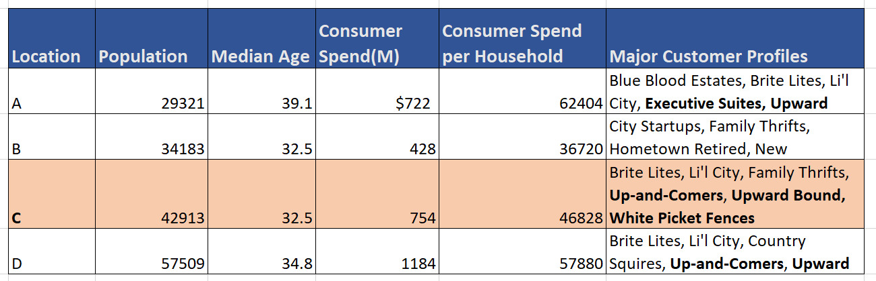

Recommendation: Location C
Team B
In addition to Sticks, customers eat at Panera, Chick-fil-A, and Chipotle a lot…and sometimes at McDonald’s and Wendys.
Location C is the best match to the business goals:
The market is large enough to support a new restaurant. It has the second highest population, highest consumer spending, and highest consumer spending per household.
This area is looking for benefits that match what Sticks offers. It includes three look-alike profiles: Up-and-Comers (Control Spending), Upward Bound (Buy Locally), and White Picket Fences (Plan, Control, & Consider).
Target specific marketing campaigns towards those three segments, but not to “Plan Carefully & Consider Health”.
Consider a shop near known Sticks competitors (Panera, Chipotle), but where there is enough restaurant variety for Sticks to differentiate itself.
Consider placing the new shop near schools, sports fields, or local attractions. Food trucks could be a good pilot during summer events and kids’ sports tournaments.
Non-customers eat at a lot of burger and sandwich restaurants. Consider emphasizing that Sticks offers sandwiches too.

